Slide 1
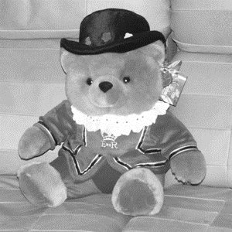
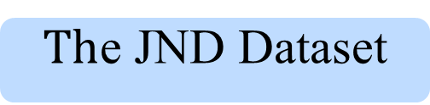
$Th$e JND Dataset
Luminance
Contrast
Structure
Ground Truth
JND Profile
Adaptive Patch Decomposition
Linear Combination
Luminance
Contrast
Structure
Reference
Loss
Discriminator
. .
. .
. . .
. .
Input
Prediction
Elementwise Sum
ConV
ReLU
BN
Transmission
Long Path Skip Connection
Short Path Skip Connection

Slide 2
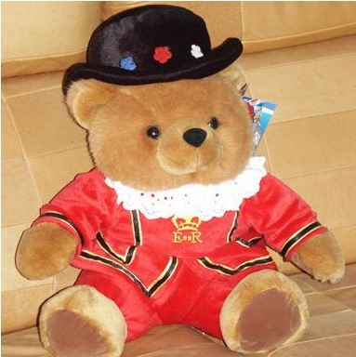
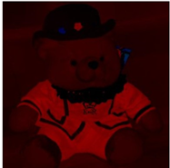

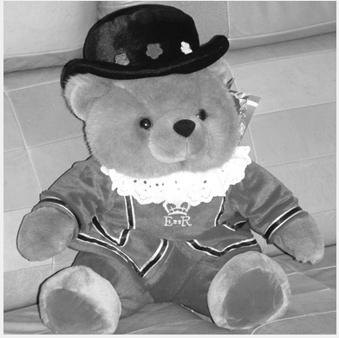
Discriminator
JND Profile Infer
Would be noticed?
N
N
N
Y
Y
Linear Combination

